Slide 1
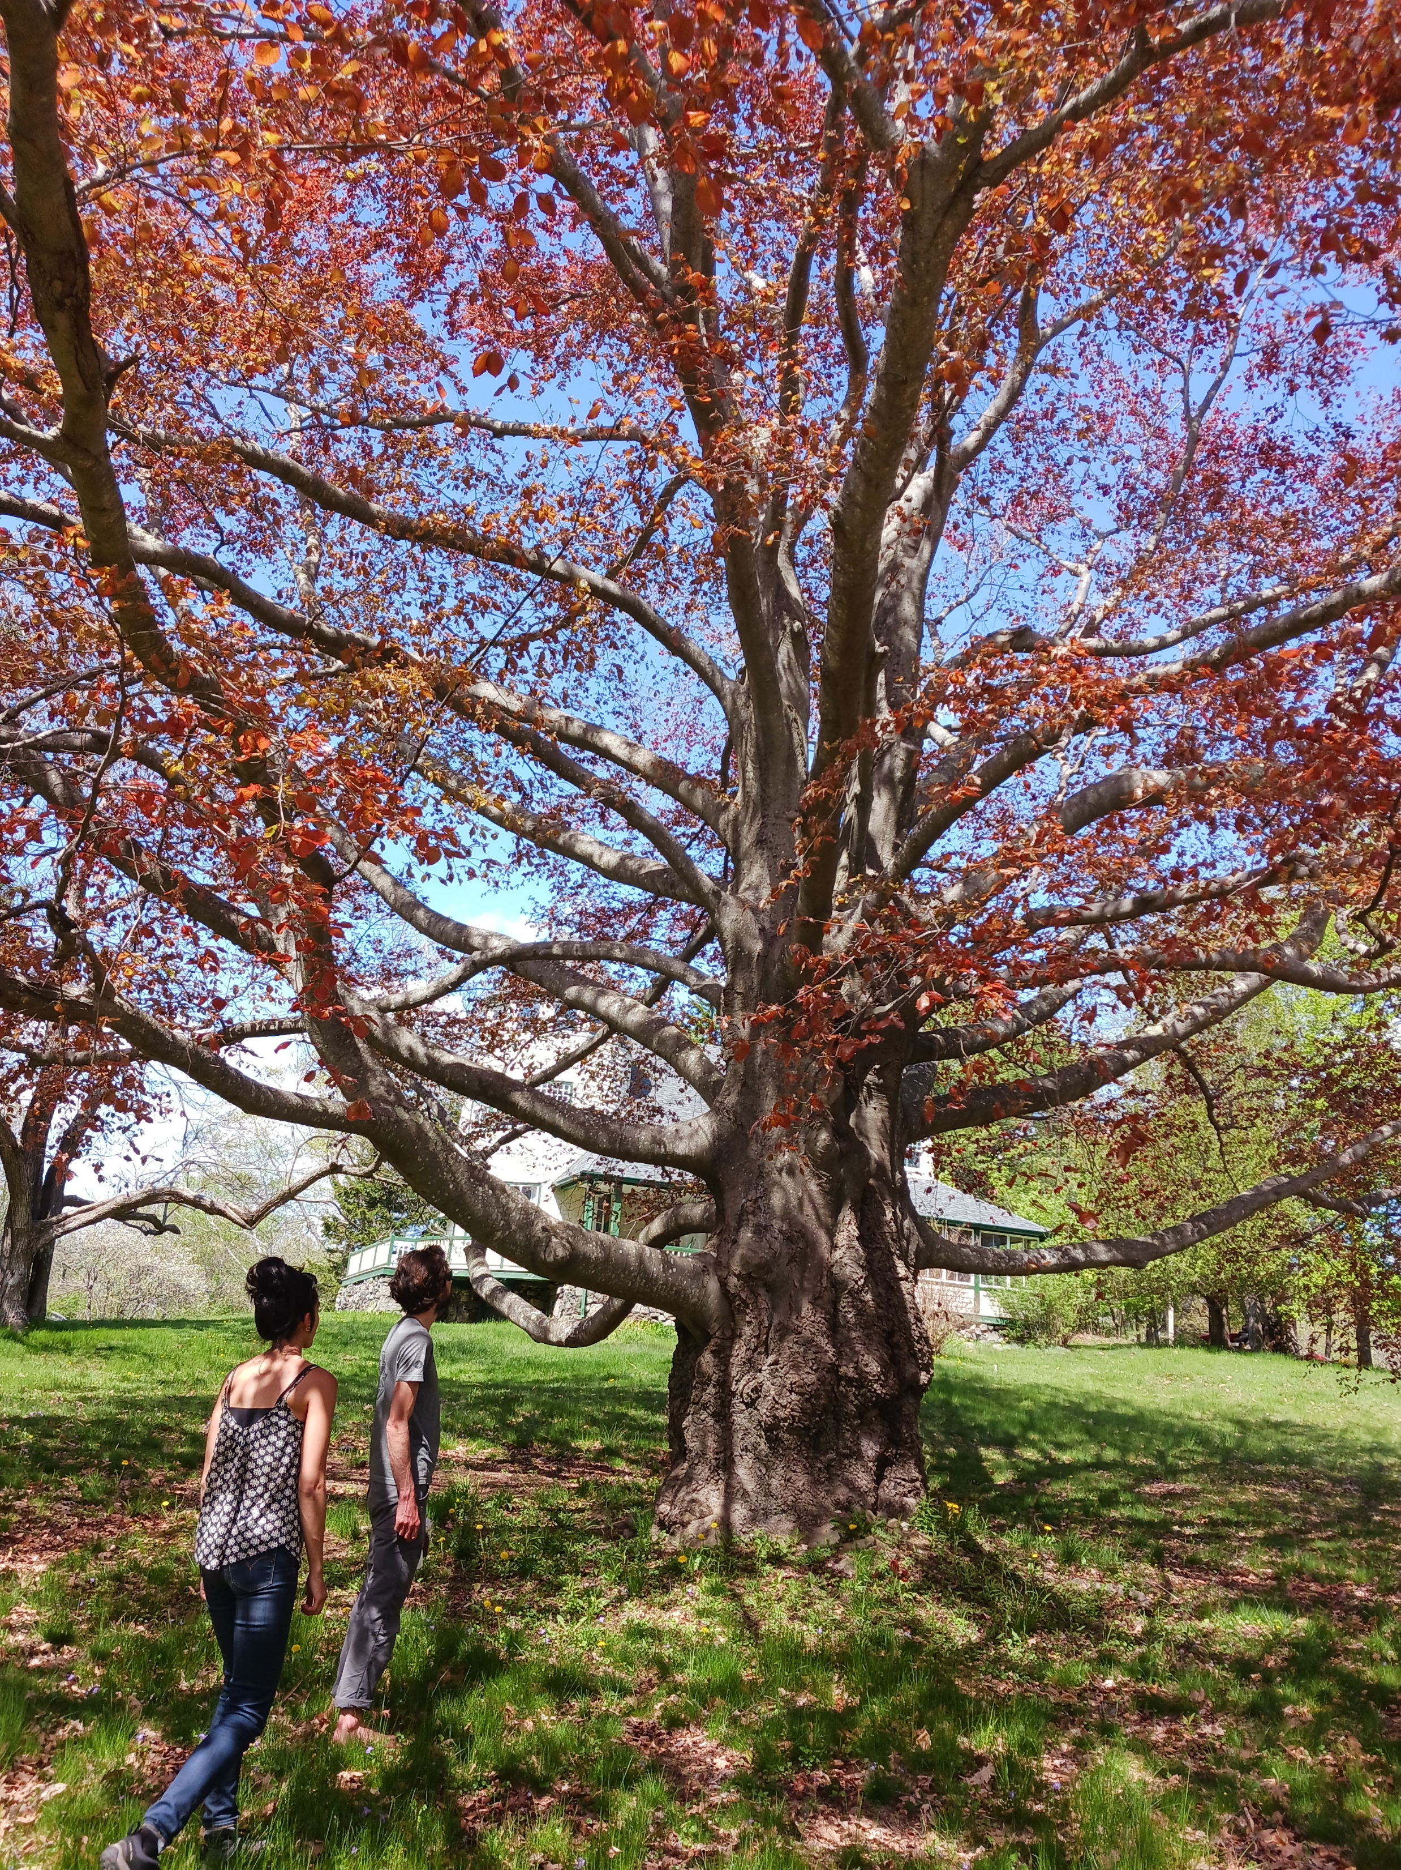
Law and the
Urban Forest:
Protecting
City
Trees

Slide 2
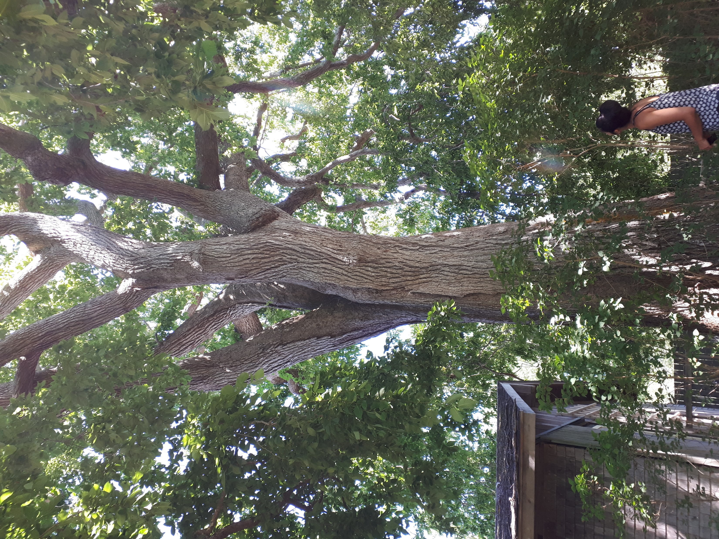
What good are urban trees?
Keep it cool
Cities are getting hotter (+3degrees from 1985 – 2020)
Direct correlation between city forest cover and summer temp

Slide 3
Emerald Ash Borer decimated tree cover in Toronto (860,000 trees within 10 yrs = approx. 8% of city’s tree cover)
Opportunity to see direct impact of tree cover on summer temperature
Trees mitigate the urban heat island phenomenon
Reference: L. Han et al. 2024. Cool cities: The value of urban trees. National Bureau of Economic Research.

Slide 4
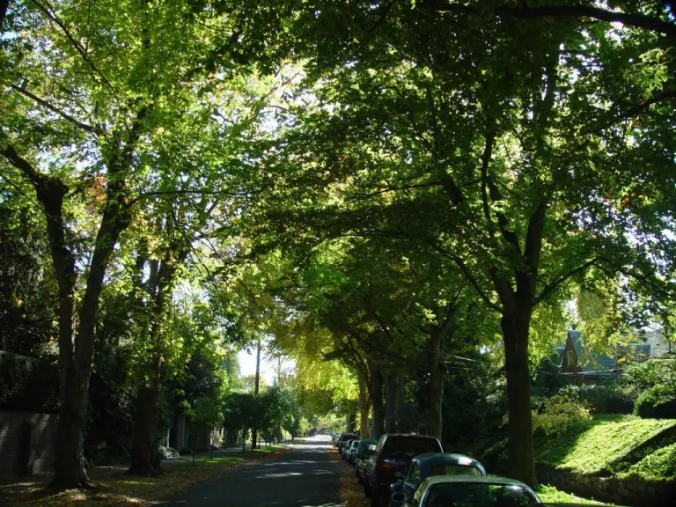
Urban Heat island effect predicted to increase
Study also found a correlation between urban canopy cover and real estate value: 1% increase in canopy = 1% increase in price
EAB – 7% canopy reduction; 7% drop in property prices

Slide 5
Energy reduction: 1% increase in canopy = 2.5% drop in energy consumption (air conditioning)
Documented disparity in tree cover between affluent and economically disadvantaged neighbourhoods
Non-linear impacts can mask advantages of trees – positive impacts increase significantly above 40% canopy cover
Important for public spaces to provide baseline of tree cover + policy to encourage tree cover on private lands

Slide 6
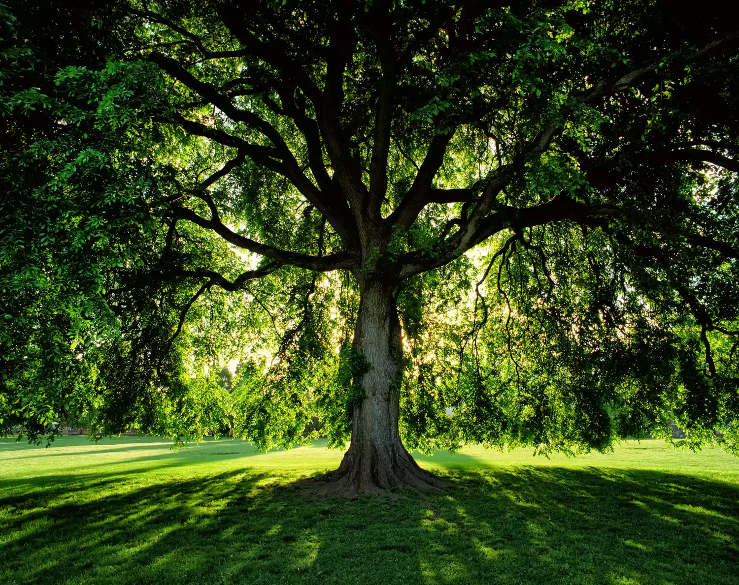
Other benefits:
Enhance aesthetics;
Provide health benefits
Reduce noise;
Improve air quality;
Shelter from wind;
Moderate storm-water runoff;
Store carbon;
Provide food and habitat for wildlife.

Slide 7
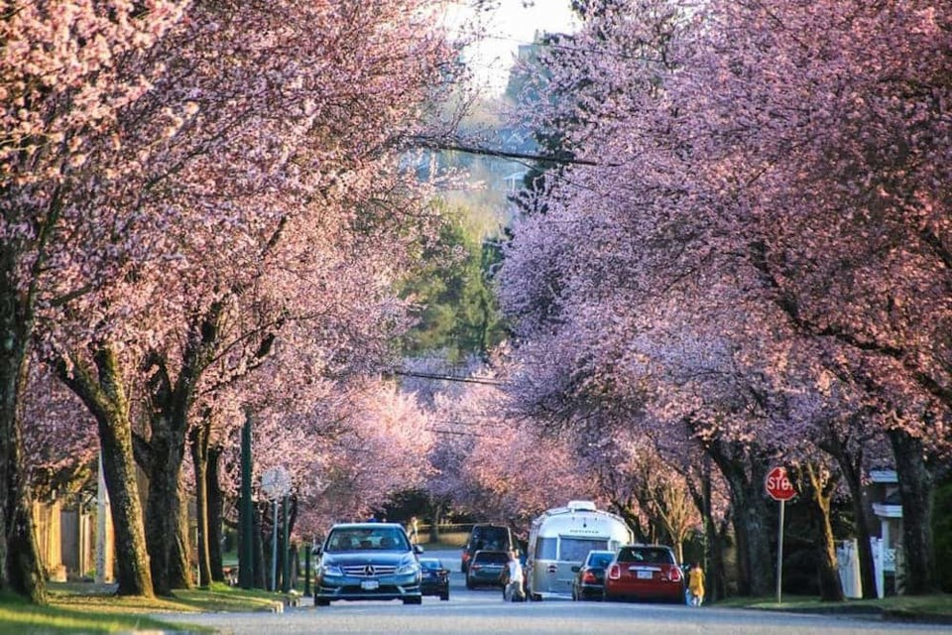
City Bylaws to Protect Trees
Vancouver:
Protection of Trees Bylaw
Applies to private and public property
Permit required to remove any tree greater than 20 cm diameter (DBH)
Replacement trees and trees part of a landscape plan for a development require permit even if less than 20cm DBH

Slide 8
Vancouver
Permit issued if…
Tree within building envelop of approved development;
Arborist certifies tree is dead, dying or hazardous, or is interfering with utility wires and pruning not an option
Plumber certifies tree interfering with sewer or drainage systems

Slide 9
Toronto
Permit required to remove trees (>30cm DBH)
Emergency work deemed by General Manager
Permit not issued for healthy trees; environmental sensitive areas; ecological systems; designated heritage tree
Permit issued for dead, dying or imminently hazardous trees; and trees within approved development plan area
Permit issued for public land trees where development work approved and no reasonable alternative (and new planting required)

Slide 10
Halifax
No restrictions on cutting trees on private land
Public land tree bylaw:
Prohibition on cutting and harming trees unless authorized
Requirement for new plantings plus $
Must protect trees near work that is not being removed
Halifax Charter:
- Enables Halifax to remove dead, dying, diseased and dangerous trees on public and private land

Slide 11
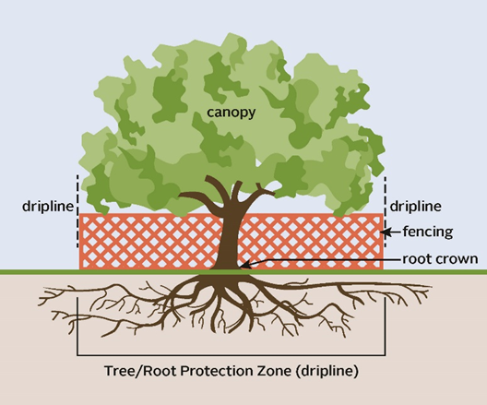

Slide 12
On-line Myths? (statements below = 100% hogwash)
Tree Service Halifax (tree-cutting company)
“When it comes to trees, you can count on Halifax is one of the most green-minded cities in Nova Scotia.
But do you need a permit to cut down a tree in Halifax?
The answer is yes. In fact, the city of Halifax requires all tree removal permit holders to obtain a permit from the city.
Tree removals are a fairly common activity in Halifax. The city has over 5,000 trees, and it is estimated that more than 70 percent of them will need to be removed during the next 20 years. The city of Halifax requires permits for all tree removals. When you remove a tree, you must have a permit from the city. The permit costs $150”

Slide 13
Quiz! Urban Trees and the Common Law
You planted a tree 20 years ago on your property. Now it’s grown so that a bit of the trunk of the tree touches on the boundary between you and your neighbour. Can you cut down the tree?
A tree your neighbour planted has grown so that its branches overhang your property. Can you cut these branches?
The tree above is an apple tree. Can you pick apples from the branches over-hanging your property? What if the apples fall onto your land, whose apples are they?
A branch from a tree on your property falls and damages your neighbour’s house. Are you liable for the damage?

Slide 14
“It may be, and probably is, generally a very unneighbourly act to cut down the branches of overhanging trees unless they are really doing some substantial harm. The case is a very common one; such trees constantly do overhang…”
Lemmon v Hebb, House of Lords, 1895

Slide 15

Thanks!
Jamie Simpson
jamie@juniperlaw.ca
www.juniperlaw.ca

